Slide 1
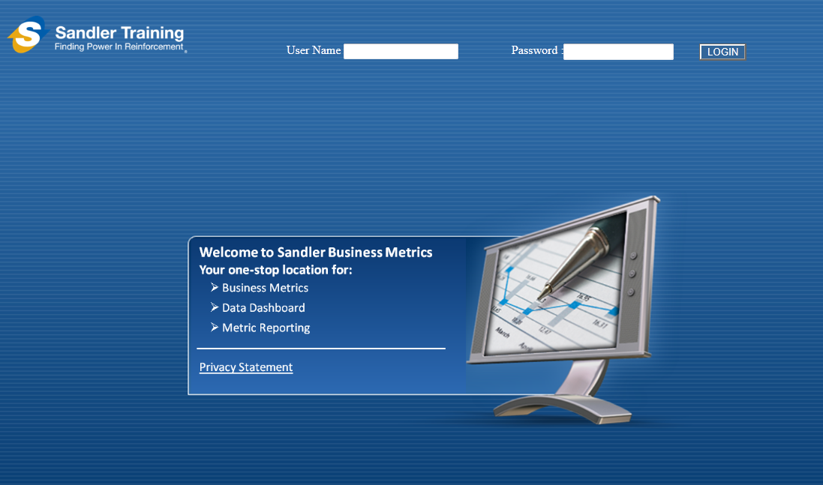

Sandler Metrics System
Powered by Mined Systems, Inc ®
Copyright © 2011 Mined Systems Metrics Intelligence. All rights reserved.

Slide 2

As a result of feedback from the Baltimore conference, and conference calls with the Beta Team we have renewed interest in the CRM that was developed for the Sandler Metrics System
Last week we performed a demo of the CRM to two groups totaling 21 users in 18 Franchises

Slide 3
Feedback from the conference and calls indicates there are fewer users on Dynamics, ACT, or Salesforce systems than we thought
The general consensus is that the Franchises want a Simpler CRM Option
Overall, Franchisees liked the Sandler Metrics System (SMS) CRM and would want migrate to the system with several requests for data as well as new functionality as follows:

Slide 4
Data Requests:
The ability to move existing data from their current CRM System one time and then use the SMS CRM exclusively thereafter
The ability to move data regularly and stay on their current system was generally from the International Franchisees (one or two)
The Franchisees liked that the data they or their Admin Staff would enter in the SMS CRM would “feed” the Metrics reports

Slide 5
New Functionality to Add:
Integrate Email
Add contacts, birthdays, and other Contact Specific Data page
Add additional Product and Data configurations
Change the Decision Tree for Company, Contacts (multiple) assigned to Sales, Permissions levels

Slide 6
New Functionality to Add:
Add Search capability to retrieve any client data including closed accounts
Create a Calendar Function
Create ability to generate a nightly “Call List” which is based on the tickler in the Calendar function

Slide 7
Consider these changes:
Send information to Karl and Sean?
Send potential revisions to KOL?
Have MSI Scope Costs?

